Slide 1



Sustainability & Personal Financial Management
How Sustainable Choices Benefit Our Planet and Our Wallets
Understanding the BAFSAM Theme & Tagline

Slide 2
Presentation Flow.
Why the Campaign.
Sustainability & the Environment.
Personal Finance Management.
Players in the Sector.
Products & Services.
Conclusion.

Slide 3






Our Sponsors

Slide 4
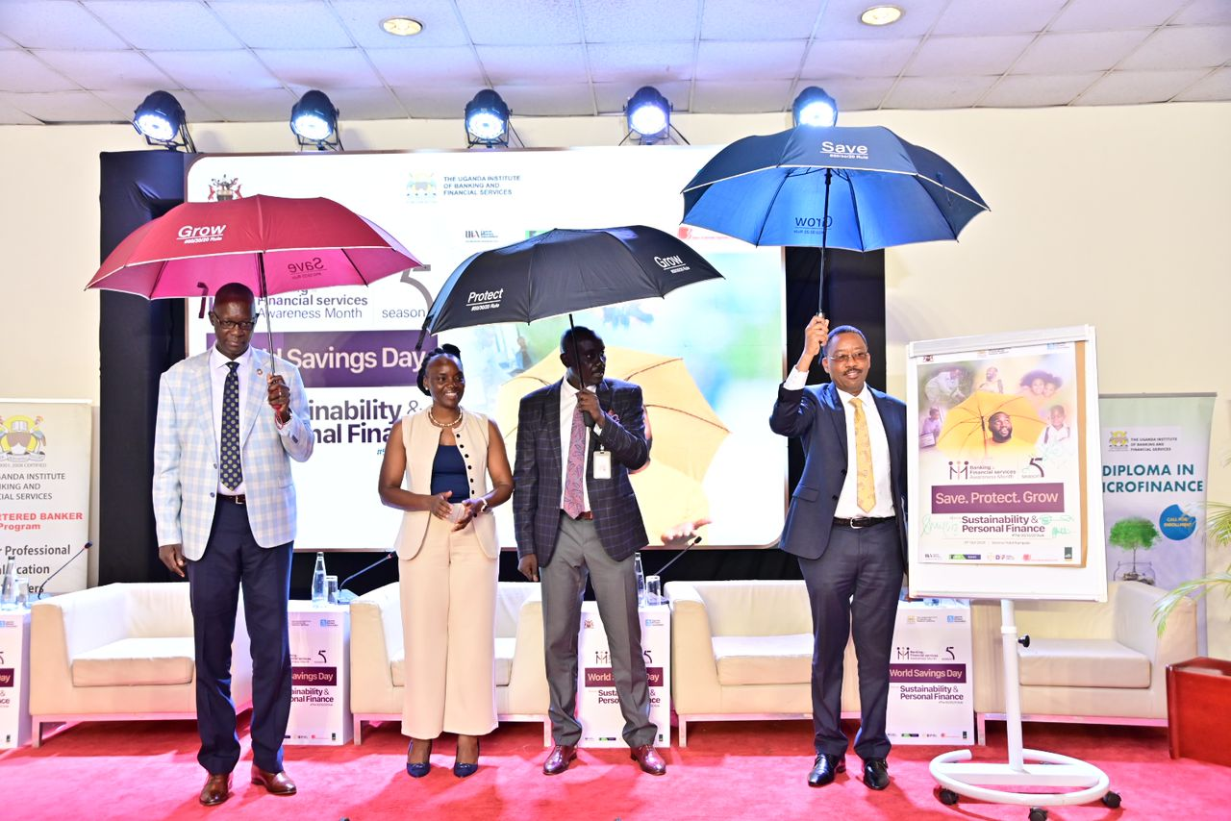
Why BFSAM 2024/25: NFIS II & NFLS I.
National Financial Literacy Strategy.
The campaign speaks directly to the implementation of Pillar 3: Financial Literacy & Consumer protection.
National Financial Inclusion Strategy II (2023 - 28).
Supporting two key Pillar; Firstly, Providing access to affordable financial products and services and Secondly, Empower consumers through education and protection.

Slide 5

Why BFSAM 2024/25
Finscope 2023.
Financial Literacy: Seven out of every 10 Ugandans were operating a personal budget deficit (needing more money than they are earning to cover their personal budget)
Nine out of every 10 Ugandans were faced by an unexpected event.
More than 7 out of every 10 Ugandans have no concrete long-term financial plans

Slide 6
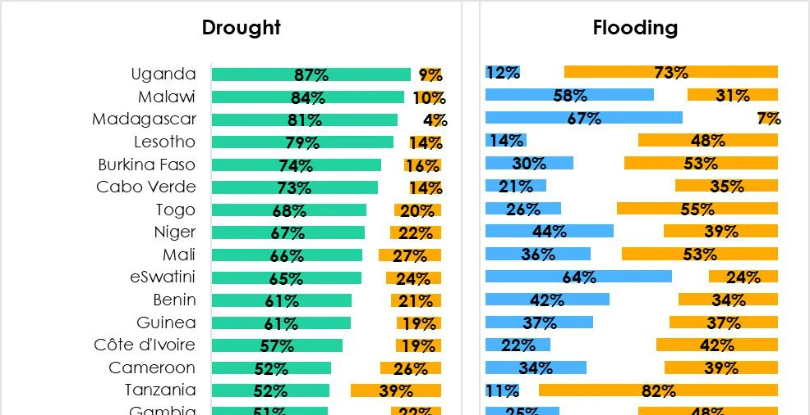
Why BFSAM 2024/25
Afro Barometer
“Africa is the most vulnerable to effects of climate change yet least prepared”
East Africans (63 percent) were almost twice as likely as North Africans (35 percent) to report that weather for growing crops had worsened. And people engaged in occupations related to agriculture (farming, fishing or forestry) were more likely to report negative weather effects (59 percent) than those with other livelihoods (45 percent).

Slide 7
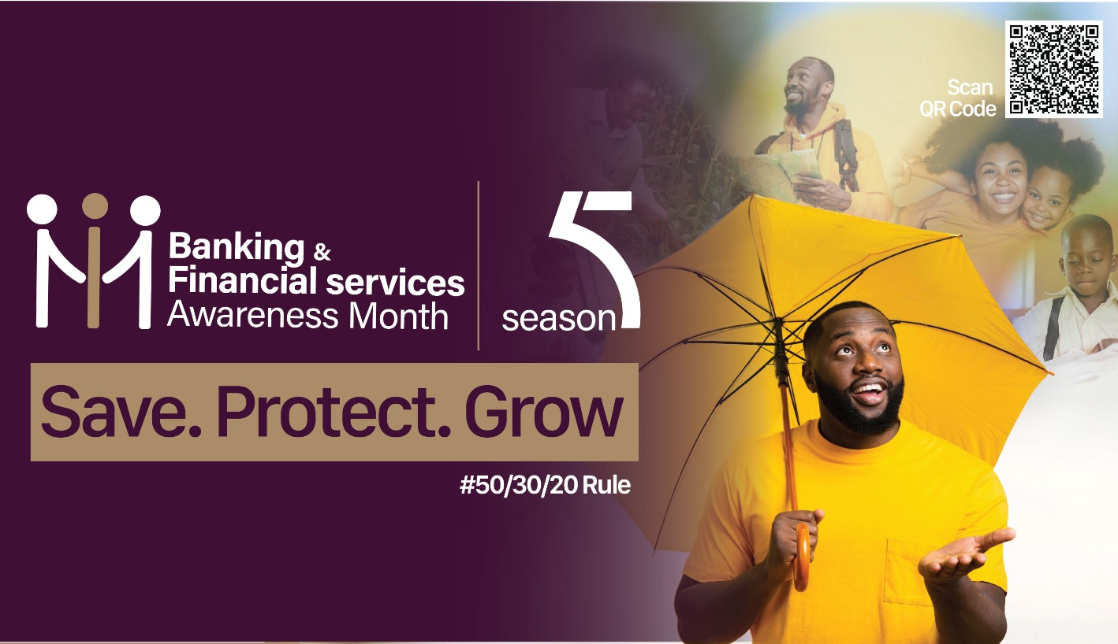
The Campaign
The Umbrella
Goals
Intentionality
Protection of Self, Family, Future, Environment

Slide 8

Sustainability

Slide 9
The reality
Sustainability is no longer a choice; it's a necessity! Our planet is facing big problems because we've been doing things in a way that harms the environment and people.
For example, our oceans are filled with too much plastic, the air in our cities is getting harder to breathe, workers are being treated unfairly, and we're using up important natural resources too quickly.
Interestingly far too many people cant meet their financial needs!

Slide 10
Sustainability Defined
The quality of being able to continue over a long/ desired time
Sustainability presumes that resources are finite, and should be used conservatively and wisely with a view to long-term priorities and consequences of the ways in which resources are used
Imagine a world where businesses prioritise environmental protection, fairness, and ethical behaviour, ensuring that prosperity doesn't come at the cost of our environment or the well-being of future generations
Sustainability in business refers to the practice of conducting operations in a way that minimises negative environmental, social, and economic impacts while fostering long-term success.

Slide 11
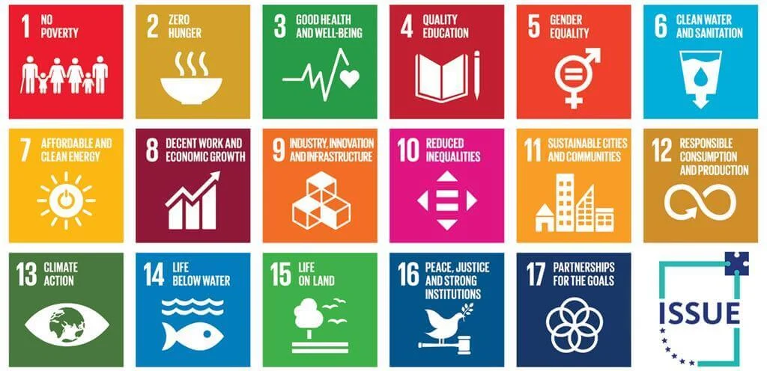
Sustainability Defined
Imagine a world where businesses prioritise environmental protection, fairness, and ethical behaviour, ensuring that prosperity doesn't come at the cost of our environment or the well-being of future generations
Sustainability in business refers to the practice of conducting operations in a way that minimises negative environmental, social, and economic impacts while fostering long-term success.
Sustainability presumes that resources are finite, and should be used conservatively and wisely with a view to long-term priorities and consequences of the ways in which resources are used
the quality of being able to continue over a period of time
UN Sustainable Development
Goals (SDGs)
VS
ESG

Slide 12
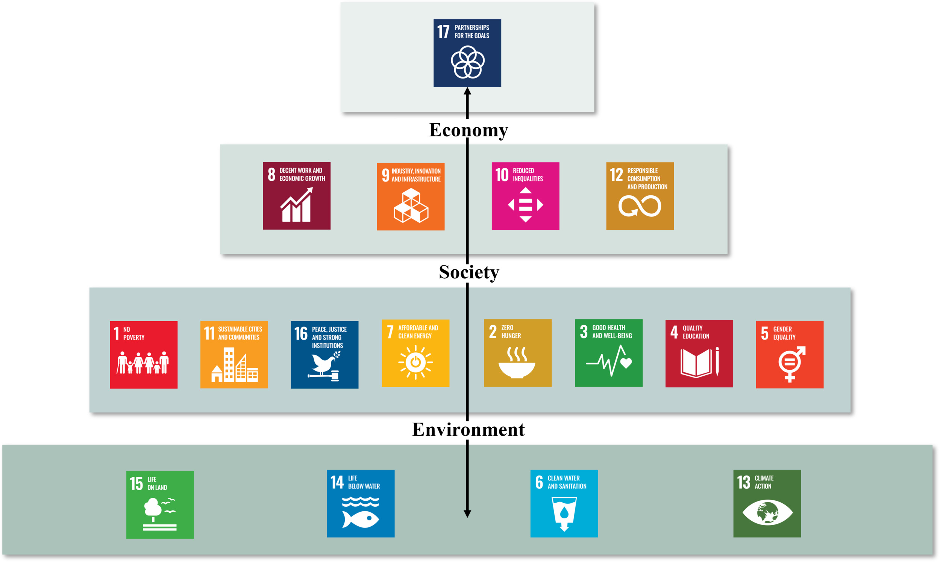
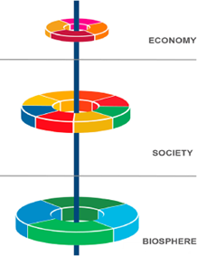
Interconnectedness and importance of the social, economic, and ecological systems to achieving the global goals.
Presented by the Stockholm Resilience Centre in 2016
The SDG Wedding Cake

Slide 13
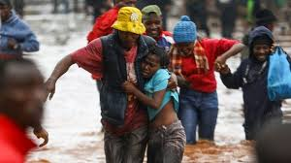
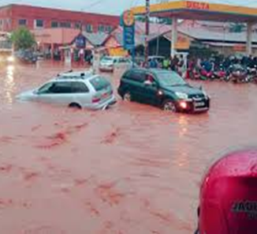
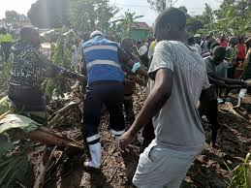
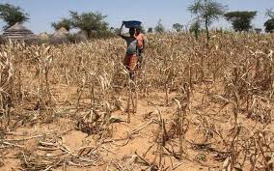
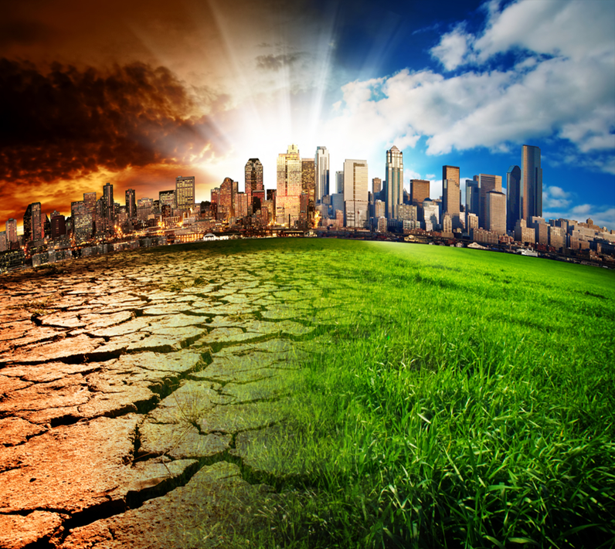
Risking our now & Future – Climate Change
Human activity: rapid industrialization, energy use, agriculture, deforestation, consumerism & practices, livestock, transport, resource extraction, pollution
Carbon / Greenhouse gas emissions : Carbon dioxide, Nitrous oxide,
Heat trapped in the atmosphere / Global Warming:
Climate change: Rising temperature, rising, sea level, unpredictable weather patterns, floods, droughts, fires, hurricanes
Effects: Famine, water contamination, property & infrastructure damage, migration, poverty, mental health, disease and death

Slide 14
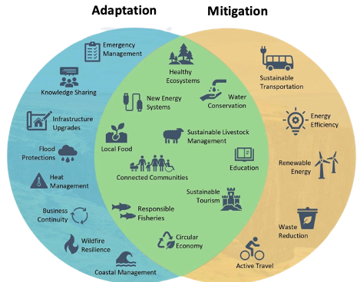
Managing the Climate Change Risk
Climate Mitigation
Actions that limit the causes of climate change to keep the global temperature rise below 2°C. i.e. reduce carbon in atmosphere
Climate adaptation
Strategies and actions taken to adjust and prepare for the current & anticipated changing climate conditions
It involves adjusting social, economic, and environmental practices to reduce vulnerability to the impacts of climate change.
Measures aim to enhance resilience, ensuring that communities, ecosystems, and economies can withstand and recover from the challenges posed by a changing climate.

Slide 15
Our Responsibility.
Role of Government
  Policy development & implementation, Resource mobilization
2. Role of Private Sector
  Policies and strategy development and implementation, responsive investment, responsible production & consumption, green finance
Role of Individuals
  Educate (Awareness) self and others, assess, strategize and plan, responsible purchases & consumption, green finance & responsive investment

Slide 16

Sustainability in Personal Finance.
SAVE, PROTECT & GROW

Slide 17
Personal Finance.
Managing personal finances has become a priority for many governments to ensure financial security and sustainability of their citizens. It means achieving and maintaining a balance between personal income and expenditure to satisfy needs, wants and aspirations within a budget, sustainably.
In Uganda’s Case: National Financial Inclusion Strategy II & National Financial Literacy Strategy I.

Slide 18
Personal Finance
Managing personal finances has become a priority for many governments to ensure financial security and sustainability of their citizens. It means achieving and maintaining a balance between personal income and expenditure to satisfy needs, wants and aspirations within a budget, sustainably.
In Uganda’s Case: National Financial Inclusion Strategy II & National Financial Literacy Strategy I.

Slide 19
Personal Finance Concepts
Personal Financial Management (PFM).
Savings.
Loans/Debt Management.
Insurance.
Planning for Old Age/Retirement.
Understanding Supervised Financial Institutions & its products.
Digital Finance.

Slide 20
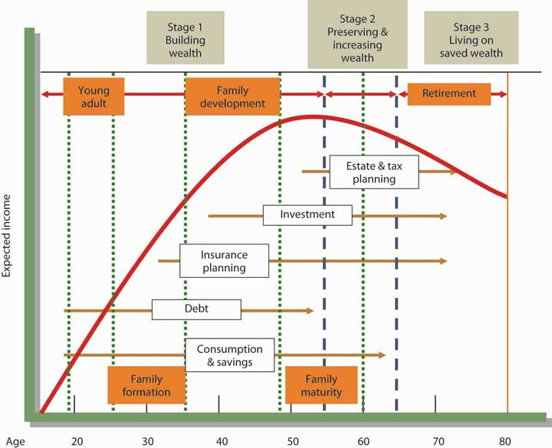
Personal Finance Concepts
Financial planning lifecycle
Life is a journey
Plan and be prepared

Slide 21
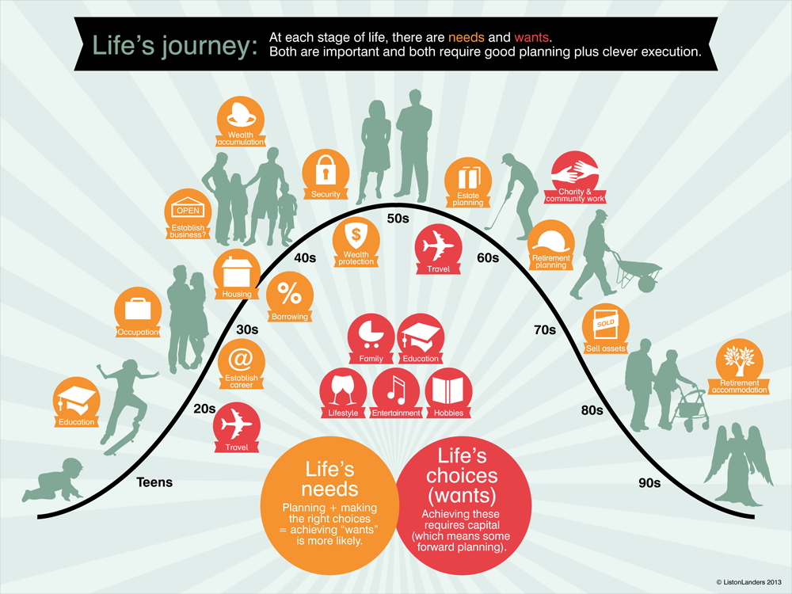
Personal Finance Concepts.

Slide 22
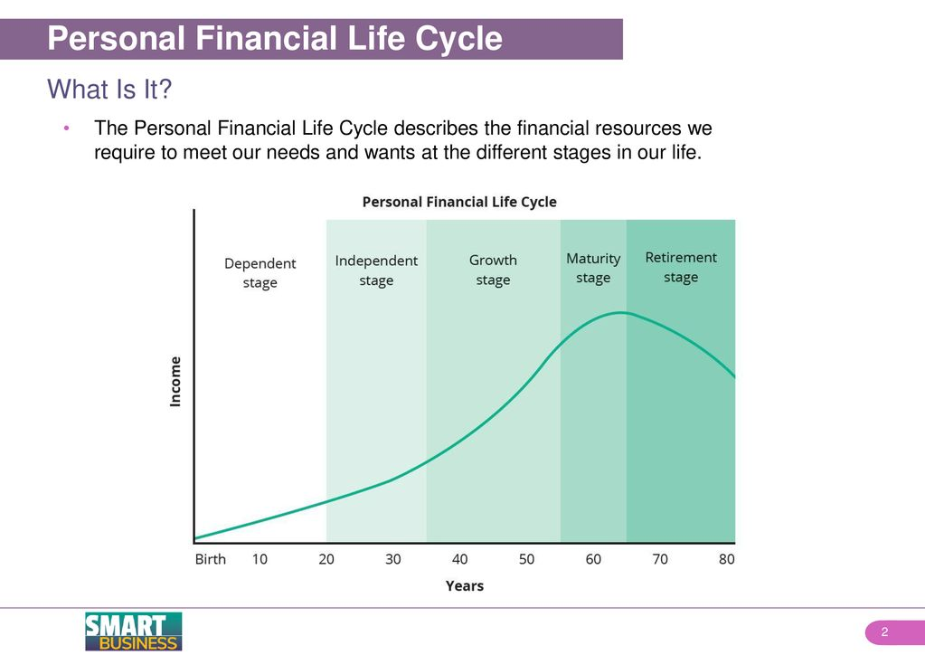
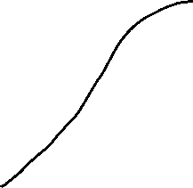
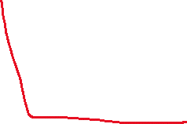

Personal Finance Concepts.

Slide 23
Players in the Market.
Savings.
  Banks i.e Digital Wallets e.g MM
  MFI’s
  Insurance Companies.
  Voluntary Saving schemes
  UBA (Association)
  UIBFS (Training School)
  Bank of Uganda & UMRA (Regulators)
Insurance.
  Insurance Companies.
  Brokers
  Agents.
  UIA (Association)
  ITC (Training School)
  Insurance Regulatory Authority of Uganda (Regulator).
  Control your expressions
Retirement.
  NSSF
  Voluntary Pensions. i.e KACITA Fund
  URBRA (Regulator)

Slide 24
Products to Support PFM.
Savings.
Create a Goal & link it to the Savings plan.
  Banks & MFI’s
  Digital Wallets e.g. MM
  Fixed Deposits.
  Automatic deductions i.e Standing Order.
Insurance.
  Guard against Risk through using an Insurer/agent or broker.
  Education plans.
  Home plans.
  Property plans.
  Get on a medical Plan
Retirement.
  Annuity Plans.
  Treasury Bills & Bonds.
  Unit Trusts.
  Stocks, Bonds or Equity.

Slide 25
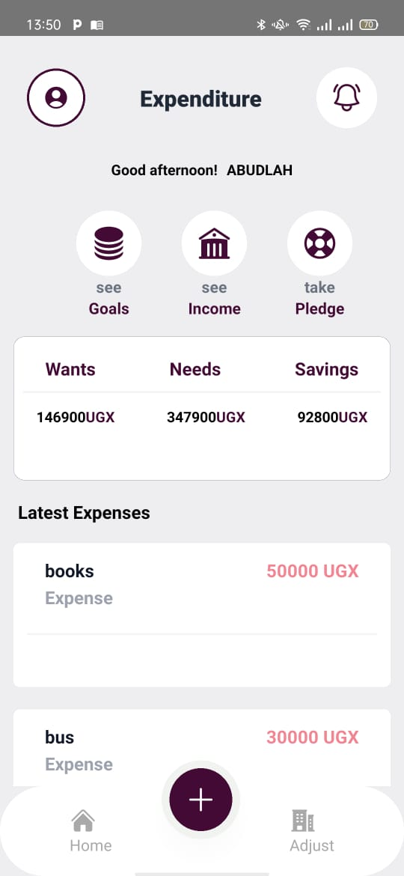
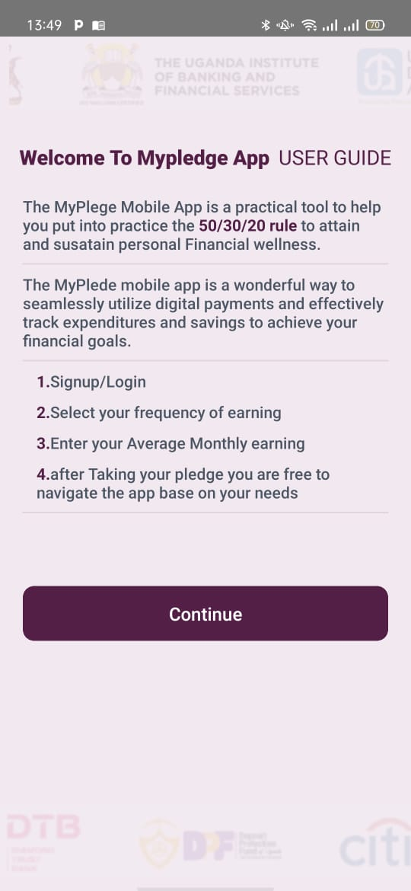
My pledge App.
Launching of the Application & Website.
a) The app is available for Android and Apple store users.
b) Volume 2: Allowing you track expenditure, Get Information on Financial Literacy modules, Tag savings to goals implementation with your bank.

Slide 26
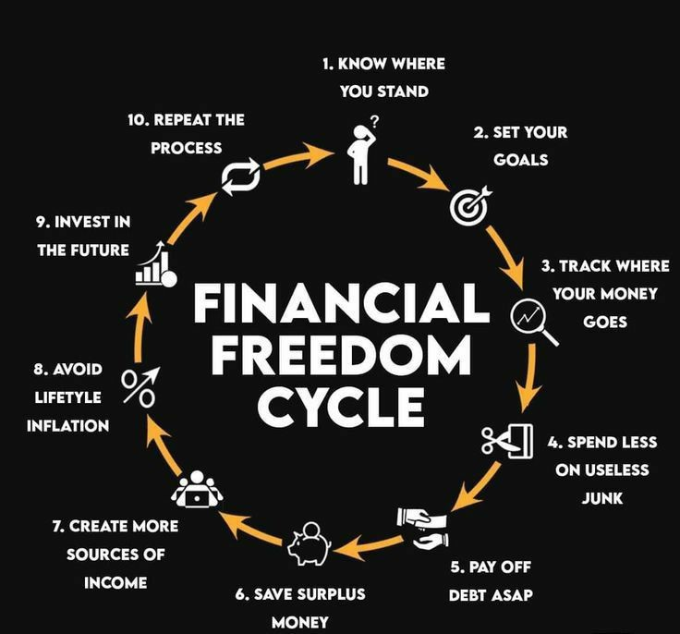
Taking Action

Slide 27
Remember
In the world of finance, where dreams take their stand, Three guiding principles, steadfast and grand. First comes the saving, a foundation so strong, A promise to future where goals all belong.
To save is to gather each dollar with care,
Building a cushion for times that are rare.
With patience it grows like a tree from a seed,
Ensuring our needs, our wants, and our heed.
Next is protecting, the shield we must wield,
Against life's uncertainties, our plan is revealed. Insurance and planning, a safety net cast, Guarding our assets, making sure they will last.
Finally, growth is the goal we pursue,
Investing in ventures where returns accrue.
Let compounding work its magical charm,
Expanding our wealth with no cause for alarm.
Save, protect, and grow—three steps to abide,
A compass to guide through financial tide.
In harmony balanced, these actions bestow,
A life of abundance, with room still to grow.

Slide 28
The journey of 1000 step begins with one step.
Thanks for Listening.

