Slide 1
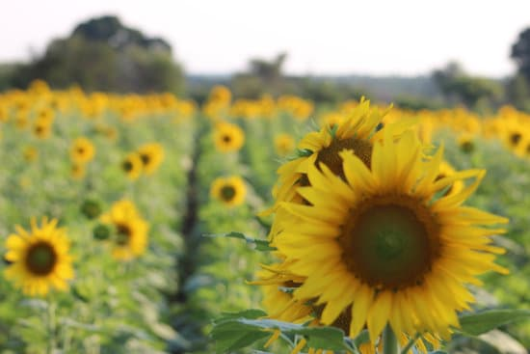
Building a Green Loan Portfolio

Slide 2
What is Green Growth (GG)?
An approach that facilitates sustainable development
An Agenda / Model / Path / Approach for fostering economic growth and development, while ensuring that we do no harm.
B. What is Green Finance?
Any structured financial activity (product or service) to finance sustainable development e.g., to create better environmental outcome like minimizing the impact on the climate

Slide 3
C. Common Terminologies in Green Growth / Linkages
Sustainable development- development that meets the needs of the present without compromising the ability of future generations to meet their own needs
Sustainable development is based on Environmental, Social and Governance Principles (ESG)
Implementation / Practicing ESG - Green Growth (GG)
Instrument for actioning – Green Finance
GG output - Environmentally and Socially Responsible Investments (ESRI) – common name SRI
Assessing SERI / green investments - Environmental & Social Performance Management (ESPM)

Slide 4
C. Common Terminologies in Green Growth / Linkages
Sustainable Development
Principle
ESG
Practice / Approach Green Growth
Instrument Green Finance
Result ESRI
Monitoring, Reporting and Verification ESPM

Slide 5
C. What are green loan portfolios?
  All loans that focus on;
    Maximize economic growth while providing social and environmental benefit directly
    Investments in current needs without compromising future needs
These will be extracted from the agriculture green taxonomy and shared with all partner financial institutions

Slide 6
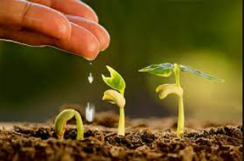
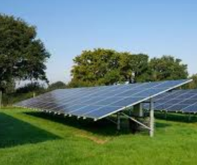
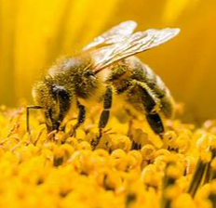
Greening Finance Focus Areas
Adaptation | Reduce the vulnerability of agribusinesses to the current and expected impacts of climate change Improved seed (early maturing, drought tolerant) Mulching, contours and trenches, Organic manure, Organic pesticides, Dry feeding – hay and silage. Agroforestry,
Mitigation | Reduce or limit green house gases (GHG) emissions Replace fossil fuels with solar or hydroelectricity Protection and/or enhancement of GHG sinks such as forests Integration of climate change in countries’ development agenda, policies, research, etc.
Biodiversity Conservation
 | Protect biodiversity below and above ground such as; Insects, worms, birds, Micro-organisms - bacteria, fungi, other animal and plant species

Slide 7
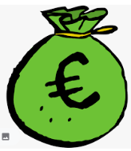


Green Finance Status
Number of partner financial Institutions: 42
Green loan products | General Agric - 42 Adaptation: 0 Mitigation: 30 FIs
Promotions | 30 FIs only promoting loans to maximize sales Not the why Need for mindset shift. Climate change is a threat to everyone Limited awareness creation for climate change adaptation and mitigation
Business Development services
 | FIs offering information green finance measures for investments - 0 FIs offering information on climate resilience in agribusiness - 0

Slide 8
D. Why green loan portfolios for financial services providers (Business Case)?
  Portfolio Growth
    Portfolio diversification
    Business sustainability / growth / increased outreach
  Portfolio Quality
    Improved credit risk management - e.g. climate proofing Agric investments, diversification
Both ultimately lead to increased profit and visibility

Slide 9
2. The Hard Elements
Strategy– Green loan portfolios do not exist in isolation or in a vacuum.
  Organizational appetite for green finance / green growth
  Does the organization have a green growth policy and strategy (Intentionality)?
    Operations strategy – Policies and manuals (environmental, infusion in other policies) - No spot fat burning
    Marketing Strategy – What is the value proposition compared to other products?
    Financing strategy – How will the product be financed?
  How does the strategy fit in with the rest of the business?
  Is it cascaded into annual plans?

Slide 10
2. The Hard Elements ctd
Structure – Does the organizational hierarchy support development of green loan portfolios?
  Representation at all governance levels from Board, Management, staff
Systems – Do the internal systems support the peculiarity of green loan portfolios?
  Independent product with product codes to avoid mix up
  Pipeline development mechanism (marketing and promotion set up)
  Assessment instruments (green intervention checklist, appraisal tools e.t.c.)
  Reporting and results measurement system

Slide 11
3. The Soft Elements
  Staff – Do you have the requisite staff?
  Skills – Do you have the skills? What is the skilling strategy? What is the retention strategy?
  Shared values – Is green growth an acceptable value within the organization? What’s the tone at the top?
  Style – What’s management’s style in driving performance, productivity, and corporate culture? Are there incentives to drive green loan portfolio growth in financial institutions?

Slide 12
Way Forward
GG Appetite
Action Planning
Commitment to Implementation

Slide 13
Don’t wait for perfection before you start. Start somewhere so you can have something tangible you can work to perfect.
– Simon Sinek
-End-

