Slide 1


ESG Standards and Frameworks for
Green Finance
14th December 2022
Notes:
Mona Opening remarks

Slide 2


ESG Frameworks for Implementation of Green Finance

Slide 3

GREEN FINANCE
Integrates the principles of environmental sustainability in its operations, promote environmental-friendly solutions in its practices and product
Focusing on a triple bottom line
Financial
Social
Environmental

Slide 4
Green Finance Implementation Environment
Pillars of FSP Business
Clients
Products and services
Processes and Systems
Structures
People
Regulations (environment)
Imperatives
Defined mission statement
Business Plan, operational plan and financial projections.
Branch and LOs performance targets and balance score cards
OPs annual plans by departments ( BD/HR/Ops/Credit e.t.c)
Clearly on-boarding processes and staff development plans.
Clear governance structures
Reporting systems (portfolio, management reports e.t.c both branch and HO)
Policies and procedures
  Risk, Operations, Credit, Audit, HR, BD, MIT, e.t.c
  JDs, Salary scales, performance appraisal e.t.c
Others….

Slide 5
Steps for implementation of Green Finance
Including environmental concerns in the mission (Your mission should reflect your ideas about environmental and social protection)
Develop an Environmental Strategy and setting quantitative objectives
Defining a formal environmental policy
Defining procedures to integrate E&S Risk analysis in the credit appraisal process
Appointing a person to manage environmental issues
Allocating human and financial resources for green activities
Reporting on environmental performance
Notes:
Most MFIs are already dedicated to create social impact but less focused on the environmental dimension of their work. If environmental impact is not integrated into the core business (including Vision, Mission, and Values) of the organization, the topic will lose attention, and all the efforts and resources that were used to address environmental issues will be wasted. The best way to integrate environmental issues into the core process of the MFI is to start with connecting your environmental and social issues to SINAPI mission, vision and values as they drive your principle strategy and business focus.
Your mission, vision and values should reflect your ideas about environmental and social protection. green agenda clearly to your mission/vision/values,
If your Vision/Mission or Values include environmental notions then it will also be easier for your employees, stakeholders, clients to refer to them and you will be able to convey a more confident environmental profile.
Vision - sets the broad, long term direction, purpose and goals of the organization. Mission - describes the path to reaching the goals set out in the Vision. Values - lays out guidelines to direct day to day activities that align with the Vision and Mission

Slide 6
Integrating Green Finance Aspects In The Credit Process

Slide 7
Standard frameworks used operationalize Green Finance
A case of SEPM

Slide 8
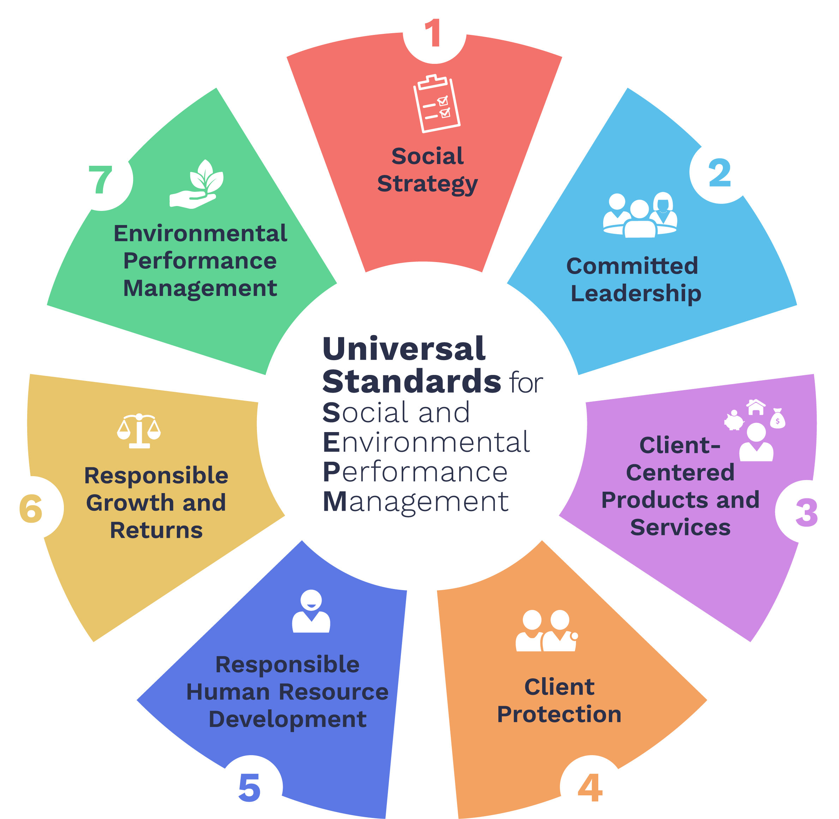
The Universal Standards for Social and Environmental Performance Management
A complete guide of best practices to help financial service providers (FSPs) put clients at the center of all strategic and operational decisions and align their policies and procedures with responsible business practices.
Notes:
There are 19 standards, organized into six dimensions.
The Universal Standards define the management practices that all financial service providers should have in place to create positive value for employees, customers, and the environment.
What are the Universal Standards for RIF and how do they help generate responsible management practices?
Earlier we learned what RIF is, and how it can benefit institutions. The next question is—what are the Universal Standards for RIF, and how are they related to responsible finance?
The Universal Standards are set of management standards that apply to all financial service providers that have a social objective.
The Universal Standards give us, for the first time, a resource that brings together ALL the existing best practices in responsible inclusive finance in ONE comprehensive manual. The point of having them all in one place is to clarify and standardize the management practices that produce positive change in the lives of customers. By clarify, I mean that the Universal Standards spell out all the essential practices in RIF, clearly showing what an institution needs to do to manage its social performance effectively. The manual is also helping to standardize practice across the industry, as it is a common set of global best practices that all institutions can use to guide their work.

Slide 9
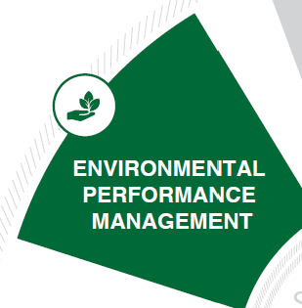
The provider has an environmental strategy and systems in place to implement it.
The provider identifies and manages environmental risks and opportunities.
The provider offers financial and nonfinancial products and services to achieve its environmental goals.
Dimension 7: Environmental Performance Management
Notes:
Slide 12: Balance Financial and Social Performance
Finally, we come back to another strategic section for the institution, and how it balances its pursuit of financial and social returns.
This strategy of an institution is dramatically influenced by the relationship with its funders, so this is a key area of focus with investors.

Slide 10
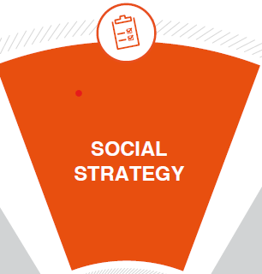
Dimension 1:
Social Strategy
The provider has a strategy to achieve its social goals.
The provider collects, analyses, and reports data that are specific to its social goals.
Notes:
Slide 7: Define and Monitor Social Goals
First, we understand that achieving a double bottom line begins with setting a social strategy.
This means that a Financial Institution knows who it is targeting, what its goals are, and has a very clear understanding of how it will balance its pursuit of financial and social returns.
Committing to such a strategy keeps the institution true to its purpose over time.
Second, it looks at ways institutions collect, report and ensure accuracy of the data collected.
By analyzing practices in this section you can see if the mission is “window dressing” or if it is indeed a guiding light for the organization.

Slide 11
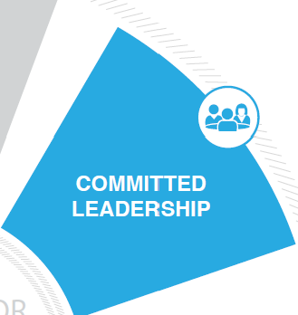
Dimension 2:
Committed Leadership
Members of the board of directors hold management accountable for achieving the provider’s social goals.
Senior management is responsible for implementing the provider’s strategy for achieving its social goals.
Notes:
Slide 8: Ensure Commitment to Social Goals
We believe that an institution must build employee buy in for its social strategy. Employees must understand the institutions strategy and how their own responsibilities contribute to achieving both social and financial goals.
Asad’s point is very important because when this commitment is encouraged and reinforced from the principals – it has a greater chance of permeating the corporate culture.

Slide 12
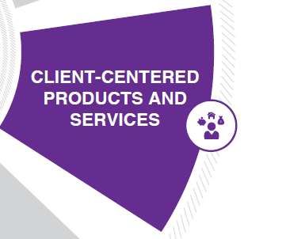
Dimension 3: Client-centred products and services
The provider collects and analyzes data to understand clients’ needs.
The provider’s products, services, and channels benefit clients.
Notes:
Slide 10: Meet Clients’ Needs
The standards go a step beyond “do no harm” of client protection and also focus on understanding the needs and preferences of different types of clients by conducting client satisfaction surveys, examining reasons clients exit the institution, using that information to adjust products and services or develop new ones.
Jurgen’s point emphasizes the importance of talking to clients to understand how services can be useful to them.

Slide 13

Dimension 4:
Client Protection
Standard 4A. The provider does not over indebt clients.
Standard 4B. The provider gives clients clear and timely
information to support client decision making
Standard 4C. The provider enforces fair and respectful
treatment of clients.
Standard 4D. The provider secures client data and
informs clients about their data rights.
Standard 4E. The provider receives and resolves client
complaints.

Slide 14
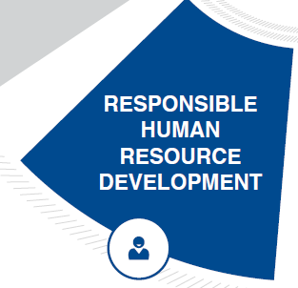
Dimension 5:
Responsible Human Resource Development
The provider creates a safe and equitable work environment.
The provider’s Human Resource Development system is designed to attract and maintain a qualified and motivated workforce.
The provider’s Human Resource Development system supports its social strategy.
Notes:
Slide 11: Treat Employees Responsibly
It is also important that employees are treated well, so that the work environment inspires and motivates them.
Employees are the front line with customers so staff satisfaction does affect customer service.
Staff turnover is also very costly, so taking care of the internal client makes good business sense.

Slide 15
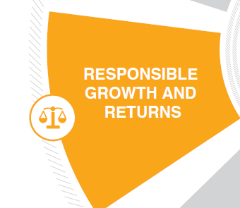
The provider manages growth in a way that promotes its social goals and mitigates risks to clients.
The provider sets prices responsibly.
The provider uses profits responsibly.
Dimension 6: Responsible growth and returns
Notes:
Slide 12: Balance Financial and Social Performance
Finally, we come back to another strategic section for the institution, and how it balances its pursuit of financial and social returns.
This strategy of an institution is dramatically influenced by the relationship with its funders, so this is a key area of focus with investors.

Slide 16
Green Finance - Economic and Social Business Case
  Higher clients retention
  Fewer loan default
  Improved reputation and credibility
  Lower staff turnover
  Better data for decision making (segmentation, etc.)
  Access to financial support and resources from social investors
  Improved clients outcome
Notes:
Improved custumer loyality
Responsible inclusive finance means implementing social performance management, putting the client at the center of institutional decision making, and ensuring that products and services create value for clients. Doing these things has positive effects on the institution’s financial bottom line as well as the social outcomes it generates for clients. There is a correlation between SPM and some improved business outcomes. For example, tracking and using social performance information to tailor products and services to clients' needs and preferences can not only improve the usefulness of those products and services for clients, but it also can increase client retention rates for the institution. Improving SPM scores has been shown to lower PAR. Putting clients at the center yields improved customer satisfaction.
To enhance the reputation and credibility of the sector and to manage the reputation risk.
To attract donor and investors and obtain additional financial support for programs with a strong social focus
To restore a balance between social and financial performance and to put back focus to clients
[ON CLICK]
Additionally, tailoring products and services to clients’ needs can reduce the likelihood of default due to client over-indebtedness.
[ON CLICK]
An additional potential benefit is improved reputation. Positive word of mouth helps an institution expand its client base.
[ON CLICK]
Responsible finance has also been shown to correlate with decreased employee turnover. Employees are motivated by working for an institution that creates benefits for clients and a supportive working environment for employees. Lower employee turnover means the institution can spend less on recruiting and training new personnel.
[ON CLICK]
Furthermore, data on social outputs and outcomes can be powerful tools for strategic planning, operational decision making, and more effective marketing. Tangible indicators of achievement can help attract funding from socially minded investors and donors.
[ON CLICK]
Additionally, institutions with strong RIF can improve client outcomes. Well-designed products can help clients cope with emergencies, invest in economic opportunities, build assets, and manage their daily and life-cycle financial needs.
[ON CLICK]
Finally, for organizations that are truly committed to their double bottom line, the most important benefit of RIF is that it helps them achieve their social goals. Time and time again, we find that institutions tell us that when they first analyzed their progress toward their mission, they learned that they were very far indeed from achieving their social goals.
For example, many institutions who thought they were serving the poor realized, once they started to measure and monitor the poverty levels of their clients, that most of their clients did not fall within the institution’s target client population.
On the other hand, the institutions that are very deliberate in how they implement RIF and have been for years, are the ones with real data showing not only that the clients they reach are their target clients, but also that these clients have experienced positive outcomes after several years with the institution.
In short, balancing financial and social performance management and implementing the Universal Standards are essential to achieving the goals that inspired you to work in microfinance.

Slide 17
Q&A
Q&A: Answers to questions raised in the chat

Slide 18

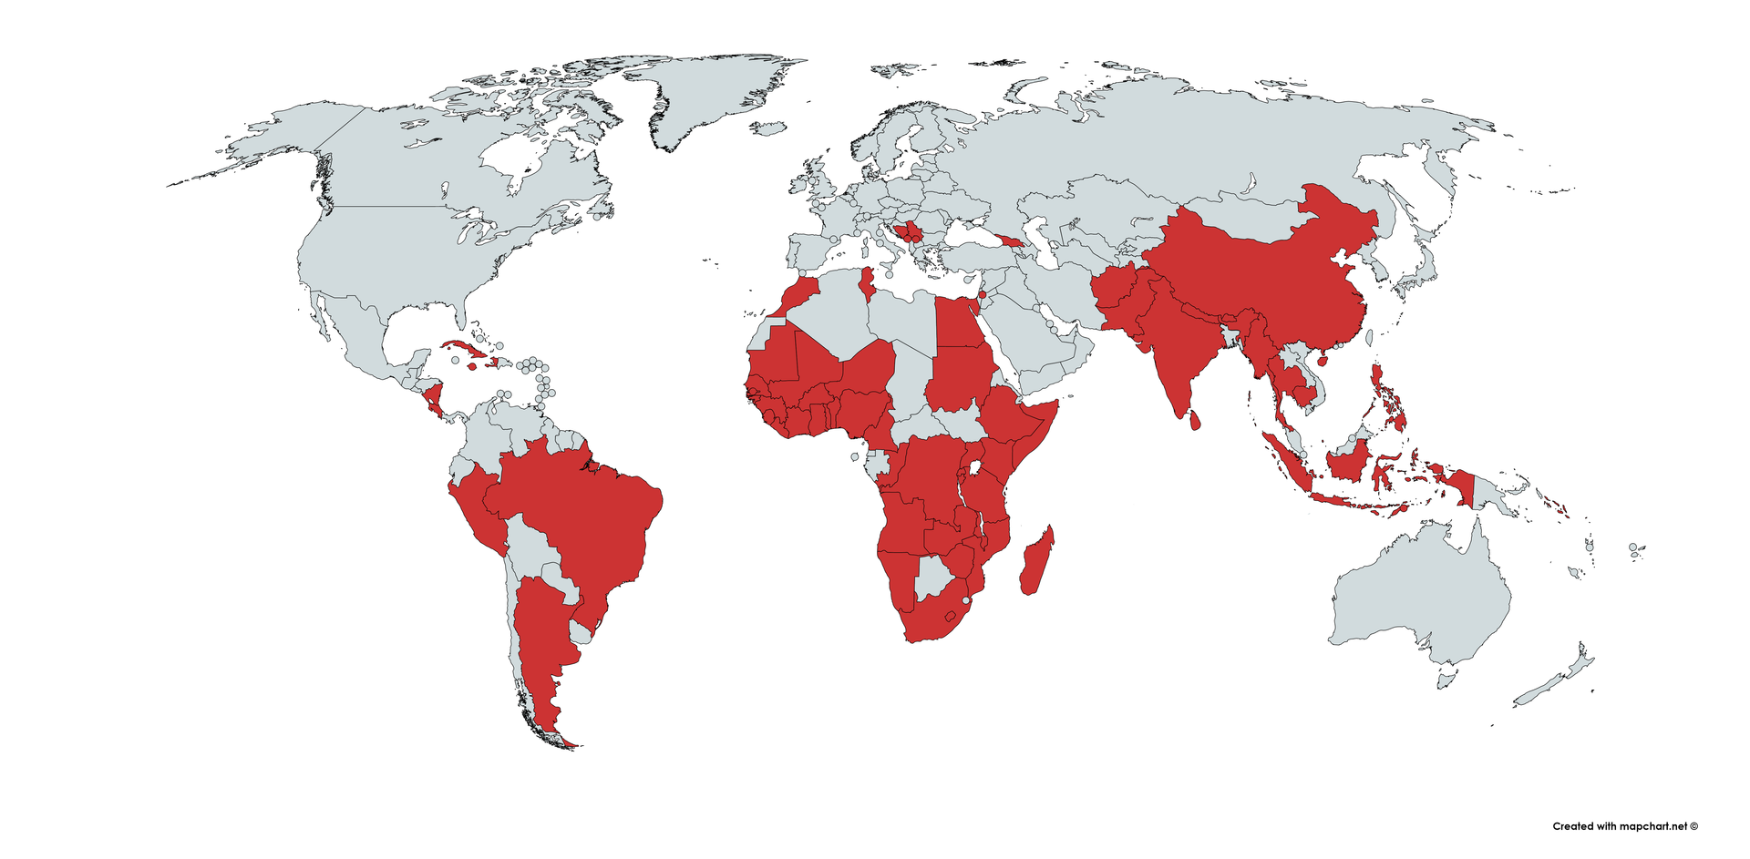

Global reach
Contacts
Ayani has conducted inclusive finance assignments in more than 60 countries
worldwide since 2008
Dennis Kiyimba
Uganda Team Leader
dkiyimba@ayani.nl
www.ayani.nl

Slide 19


