Slide 1
“Early Planning For A Happy Retirement”
Martin A. Nsubuga
Chief Executive Officer
UGANDA RETIREMENT BENEFITS REGULATORY AUTHORITY
Tuesday November 23rd, 2021

Slide 2
Some Retirement Facts
While your regular INCOME stops, your EXPENSES don’t!!!!!!!!
Your title changes – RETIRED CITIZEN
The number of people by your side will dwindle. You will be the minority – Demographic Pyramid.
Separated from your routine friends at the work-place Loneliness
Health challenges start creeping in – Health & Age are twin brothers
More time at your disposal

Slide 3
Some Retirement Facts cont’d
People are living longer – Longevity Risk
Traditional support system of the aged is decreasing
Budgetary constraints to provide social security to all Ugandans
You will need about over 70% of your final salary to have financial security in retirement
A lot will depend on how you prepare for your retirement.

Slide 4
NSSF Post Retirement Survey Report
Majority of Members start to save late – @38year on average (implies 17yrs savings to 55yrs of retirement)
Average payout – Shs.24 million - Implies annual savings of <Shs1.0m (<100k per month)
Just 53% of the beneficiaries could be sustained by their benefits for a year

Slide 5

What next? (1)Build a pot for future cashflows
Start saving, Start Small and Be Consistent
  If you are already saving, whether for retirement or another goal, keep going!
  If you’re not saving, it’s time to get started. Don’t wait when its too late!
  Start small if you have to and try to increase the amount you save each month.
  The sooner you start saving, the more time your money will have to grow
  Make saving for retirement a priority.

Slide 6
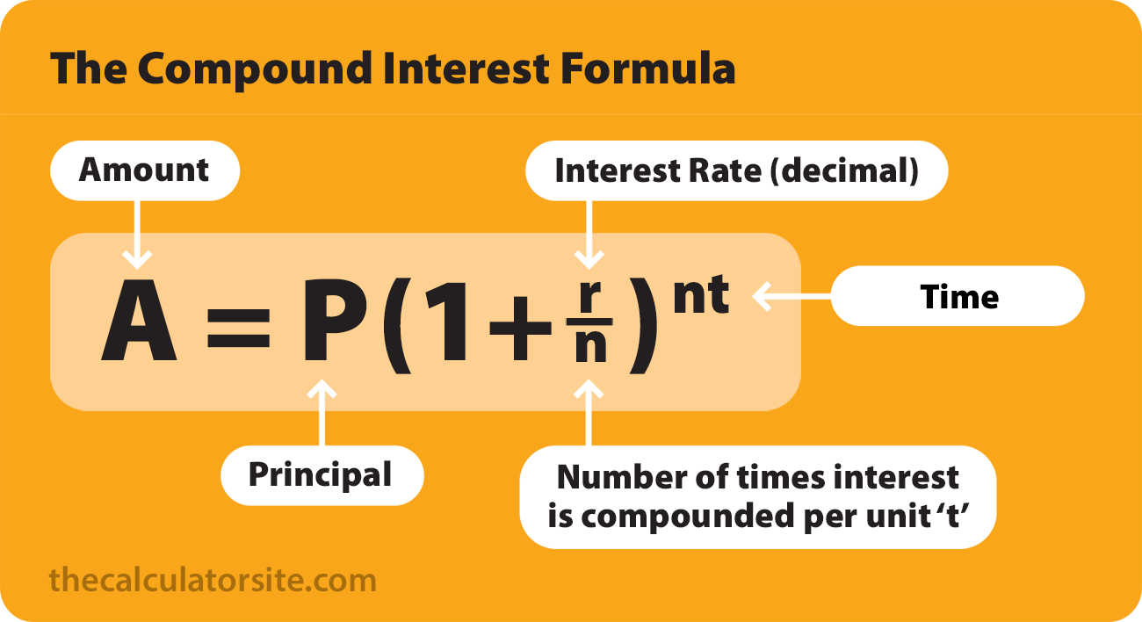
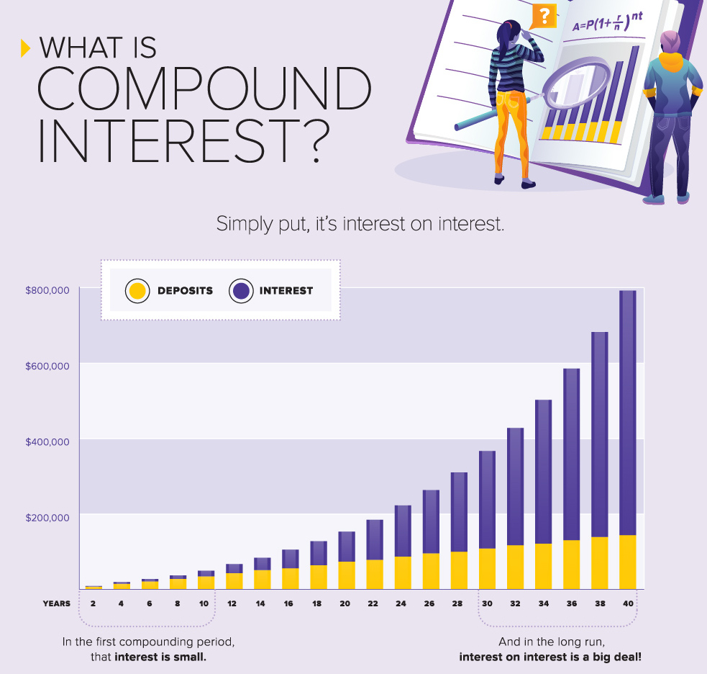
Concept of Compound Interest

Slide 7
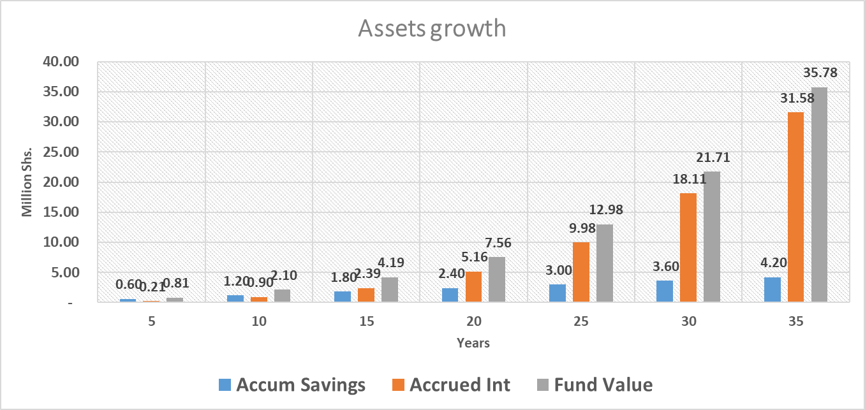
Illustration: - Concept of Compound Interest
This chart demonstrates what you would
accumulate at 5, 10, 15, 25, 30 and 35 years if you
saved Shs.10,000 monthly (120,000 annually) and your money earned 10% annually.

Slide 8
What next? (2)Let it Grow
Don’t touch your retirement savings
  If you withdraw your retirement savings now – Opportunity Cost
  Preserve you savings and benefits: If you change jobs, leave your savings invested in your current retirement plan, or roll them over into an your new employer’s plan.
  Consider an Individual Retirement Plan too!
    Contributing to NSSF; or
    Voluntary Schemes licensed by URBRA

Slide 9
Non-financial considerations
While a retirement without money doesn't sound like much of a retirement, “focusing exclusively on the monetary aspects of the planning is missing the big picture”.
A happy retirement is not only about having enough money to pay your bills.
Also consider the non-financial aspects of a successful retirement.

Slide 10
Some of the happiest and most content retirees have a few things beyond financial security in common.
MICHAEL RUBIN Updated October 22, 2018

Slide 11
What do you to do? You may need to Work
Sounds contradictory!
Equip yourself with knowledge that could be useful in retirement
Build a great reputation of professional competence
Integrity, ethical etc

Slide 12
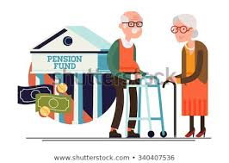
Maintain Good and Great Relationships
Build both romantic and platonic Relationships now for an enjoyable retirement.
Married retirees in good or great relationship with their spouse are reportedly happier than their single counterparts.
Develop a social network for a happy retirement now. Join social clubs i.e. Rotary, Lion, Church, Community works, community leadership.
Build a great relationship with God

Slide 13

Find Hobbies and Stay Busy
How will you fill your days?
Identify a hobby that you will also enjoy doing in retirement
Identify now something that will keep you busy in retirement.

Slide 14
Be Active and Healthy
Your health when it comes to your happiness can't be overstated.
Maintain good health habits now for an enjoyable and happy retirement.
While you can't predict health concerns, the best step is preventative. Take care of yourself now for a better retirement.

Slide 15
Retirement” is a phase of life where one’s regular source of income ceases.
Retirement” is just the last stage of life to enjoy or suffer.
While your INCOME stops, your EXPENSES don’t!!!!!!!!
Bottom line!
You will still need a “cash-flow” to live longer

Slide 16

Thank You…
Protecting Your Retirement Benefits
Uganda Retirement Benefits Regulatory Authority (URBRA)
Plot No. 1, Clement Hill Rd (4th - 6th Floor) | P.O. Box 7561, Kampala
urbra@urbra.go.ug
+256200513500 / +256312324500 / +256417304500
www.urbra.go.ug

